Slide 1
Q-Anal
An algorithm for Comparative qPCR analysis
Dan Kelliher 20FEB19

Slide 2
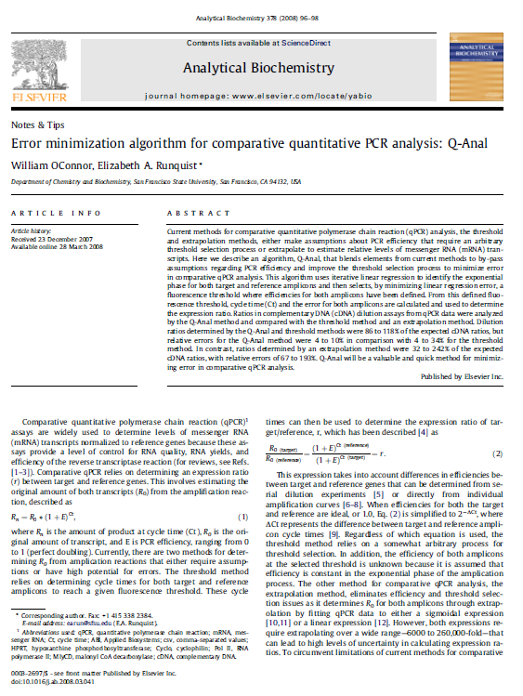
Introduction
I had the opportunity to participate in undergraduate research under Dr. Elizabeth Runquist while working on my bachelor’s during 2007-2008.
In this work I prepared and ran qPCR assays and performed basic data analysis.
I received acknowledgement for my technical support in the following publication
W. O’Connor, E. Runquist, Error Minimization Algorithm for Comparative Quantitative PCR Analysis: Q-Anal, Analytical Biochemistry 378 (2008) 96-98

Slide 3
Quantitative PCR Background
mRNA transcription is an indication of gene expression. The level of mRNA (expression) can be measured by producing cDNA from an mRNA sample via reverse transcriptase and performing quantitative PCR (qPCR).
qPCR monitors the amplification of cDNA in real time. The qPCR regents include a nonspecific, fluorescent dye and the amount of fluorescence detected after each PCR cycle is relative to the amount of cDNA in the sample.
As a reminder: the progress of a PCR reaction takes on a sigmoidal shape. There is an “exponential” phase where DNA is copied at a near perfect doubling (during this phase the line has a slope of 1).

Slide 4
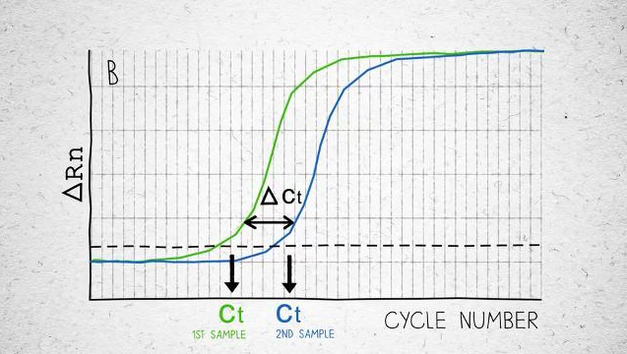
Comparative qPCR
Gene expression levels can be compared to one another by observing their amplification behavior during the exponential phase of the PCR reaction.
The amount of time (cycle time) required for the target cDNA sample to reach a given fluorescence level is compared to the cycle time required for a reference gene cDNA sample to reach the same fluorescence level.

Slide 5
Comparative qPCR
R₀ (target) / R₀ (reference) = (1 + E)^{Ct(reference)} / (1 + E)^{Ct(target)} = r R₀ : Fluorescence (expression level) at time zero
E: gene efficiency Ct: cycle time r: expression ratio
The above expression uses cycle time to determine the expression ratio of target gene / reference gene and takes into account differences in efficiencies between target and reference genes.
When efficiency is ideal, or 1 (perfect doubling during the exponential phase), the equation can be reduced to the following:
(1 + 1)^{Ct(reference)} / (1 + 1)^{Ct(target)} = 2 ^{-∆ct}

Slide 6
Comparative qPCR Analysis Methods
The Q-Anal algorithm sought to improve qPCR data analysis over both the threshold and extrapolation method though an improved threshold selection method.
The threshold method uses an arbitrary threshold selection process and assumes that the efficiency is constant during the exponential phase of the amplification process.
The extrapolation method eliminates efficiency and threshold selection and estimates R₀ for both amplicons by fitting a sigmoidal or linear curve. This method extrapolates over a wide range leading to high levels of uncertainty.

Slide 7
Q Anal Algorithm
The Q-Anal program requires input from two csv files: the raw R_{n} file and a user description file describing the plate-well positions and proceeds though the following steps:
Identifies which data is “valid for analysis” by using a Q Test (a statistical method for identifying outliers).
Performs iterative linear regression using three to six valid data points until data with a slope (efficiency) close to 1.0 are found.
Once lines for both amplicons that have similar efficiencies are defined, a fluorescence threshold is determined by error minimization and the resulting cycle times at this threshold are then used to calculate the expression ratio (2^{-∆ct}).

Slide 8
Test Methods
Q-Anal was compared with both the threshold and the extrapolation method using four amplicons:
HPRT (hypoxanthine phosphoribosyltransferase)
Cyclo (cyclophilin)
Pol II (RNA polymerase II)
Mly CD (malonyl CoA decarboxylase)
For the threshold method, fluorescence thresholds were either manually selected or auto-selected using software.
For the extrapolation method, the initial amount was calculated from the intercepts of the best fit lines calculated by the Q-Anal algorithm

Slide 9
Results
cDNA dilution ratios for both Q-Anal and the threshold method were 86-118% of the expected cDNA ratios.
Relative errors for the Q-Anal method (4-10%) were reduced in comparison with the threshold method (4-34%).
The magnitude of relative error in the dilution ratios determined by Q-Anal depended on the number of points used to define the lines; the relative error was higher when 6 points were used.

Slide 10
Summary
Q-Anal uses iterative linear regression to identify the exponential phase for both target and reference amplicons and then selects, by minimizing linear regression error, a fluorescence threshold in this region where efficiencies for both amplicons have been defined.

